Slide 1

ECE 478-578 Intelligent Robotics I
PhD. Husnu Melih Erdogan – Electrical & Computer Engineering
herdogan@pdx.edu Teaching Assistant – Lab Assistant

Slide 2

Lecture 16 Introduction to ROS

Slide 3
ROS (Robot Operating system)

Slide 4

Course Structure
ROS Services and Messages
Writing a Service and Client
ROS .bag file
URDF
TF
RVIZ
Getting started with Turtlebot
MoveIt
Creating Vikingbot URDF
Robot_State_Publisher
Joint_State_Publisher
Gazebo
What is ROS?
Introduction to ROS
ROS architecture, philosophy, history
How to install ROS?
Examples
XML Format
ROS commands
Getting familiar with the ROS filesystem
How to create a ROS package?
How to build a ROS package?
How to install released ROS packages?
How to build packages from source?
ROS Nodes Detail
ROS Topics Detail
Writing a Publisher and Subscriber

Slide 5
What is ROS?
ROS stands for Robot Operating System.
However it is not a real operating system such a Linux, Windows, OSX
It is framework.
It is more like a middleware that sits between your operating system and your program in C++, Python, and Matlab etc.

Slide 6

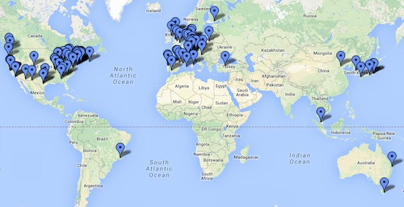
Why ROS is useful?
A distributed, modular design
A very large community
Permissive Licensing
"lets people do anything they want with your code as long as they provide attribution back to you and don’t hold you liable."
Collaborative Environment
It is free.
Supports different programming languages
Matlap, C++, Python, Lisp
A very important technical skill to have in your resume.

Slide 7

History of ROS
It is developed in 2007 at the Stanford Artificial Intelligence Lab.
It was managed by Willow Garage.
Open Source Robotics Foundations has been managing it since 2013.

Slide 8
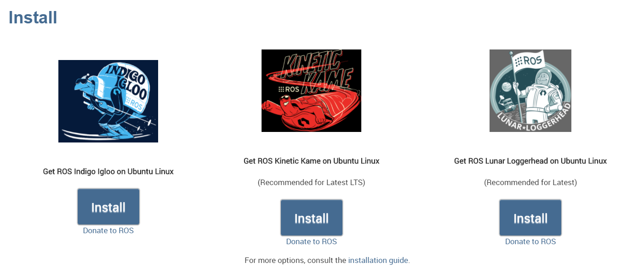
Current Distributions

Slide 9

ROS Industrial
ROS-Industrial is an open-source project that extends the advanced capabilities of ROS software to manufacturing.
http://rosindustrial.org/

Slide 10
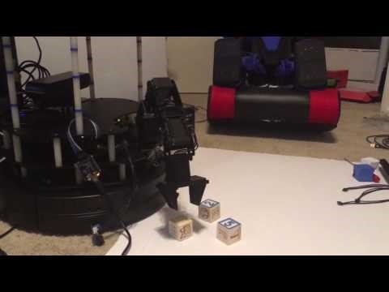
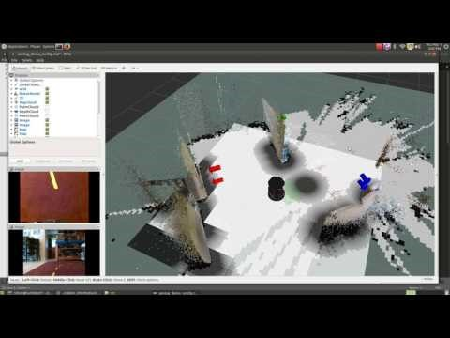
Turtlebot

Slide 11
ROS Philosophy
Peer to Peer
Individual programs communicate over defined API (ROS messages, services)
Distributed
Programs can be run on multiple computers and communicate over the network.
Supports Multiple Languages
ROS modules can be written in any language for which a client library exist (C++, Python, MATLAB, Java, etc.)
Light-weight
Stand-alone libraries are wrapped around with in a thin ROS layer.
It doesn’t mean ROS doesn’t use your CPU or don’t need a powerful PC.
Some packages could use all almost your system resources.
Free and Open-Source
It is totally free and supported by a considerably large community.
It is backed by many universities and industrial companies.
It becomes a standard in the robotics field.

Slide 12
ROS Core Components
There are three core components:
Communications Infrastructure
Robot-Specific Features
Tools

Slide 13
Communications Infrastructure
At the lowest level, ROS offers a message passing interface that provides inter-process communication and is commonly referred to as a middleware.
The ROS middleware provides these facilities:
publish/subscribe anonymous message passing
recording and playback of messages
request/response remote procedure calls
distributed parameter system

Slide 14
Message Passing
A communication system is often one of the first needs to arise when implementing a new robot application.
ROS's built-in and well-tested messaging system saves you time by managing the details of communication between distributed nodes via the anonymous publish/subscribe mechanism.
Another benefit of using a message passing system is that it forces you to implement clear interfaces between the nodes in your system, thereby improving encapsulation and promoting code reuse.
The structure of these message interfaces is defined in the message IDL (Interface Description Language).

Slide 15
Recording and Playback of Messages
Because the publish/subscribe system is anonymous and asynchronous, the data can be easily captured and replayed without any changes to code.
Say you have Task A that reads data from a sensor, and you are developing Task B that processes the data produced by Task A. ROS makes it easy to capture the data published by Task A to a file, and then republish that data from the file at a later time.
This is a powerful design pattern that can significantly reduce your development effort and promote flexibility and modularity in your system.
We can run the robot itself only a few times, recording the topics we care about, and then replay the messages on those topics many times, experimenting with the software that processes those data.

Slide 16
Remote Procedure Calls
The asynchronous nature of publish/subscribe messaging works for many communication needs in robotics, but sometimes you want synchronous request/response interactions between processes.
The ROS middleware provides this capability using services. Like topics, the data being sent between processes in a service call are defined with the same simple message IDL.

Slide 17
Distributed Parameter System
The ROS middleware also provides a way for tasks to share configuration information through a global key-value store.
This system allows you to easily modify your task settings, and even allows tasks to change the configuration of other tasks.

Slide 18
Robot-Specific Features
In addition to the core middleware components, ROS provides common robot-specific libraries and tools that will get your robot up and running quickly. Here are just a few of the robot-specific capabilities that ROS provides:
Standard Message Definitions for Robots
Robot Geometry Library
Robot Description Language
Preemptable Remote Procedure Calls
Diagnostics
Pose Estimation
Localization
Mapping
Navigation

Slide 19
Tools
One of the strongest features of ROS is the powerful development toolset.
These tools support introspecting, debugging, plotting, and visualizing the state of the system being developed.
The underlying publish/subscribe mechanism allows you to spontaneously do self-analysis of the data flowing through the system, making it easy to comprehend and debug issues as they occur.
The ROS tools take advantage of this introspection capability through an extensive collection of graphical and command line utilities that simplify development and debugging.

Slide 20
Command-Line Tools
ROS can be used 100% without a GUI.
All core functionality and introspection tools are accessible via one of more than 45 ROS command line tools.
There are commands for launching groups of nodes;
introspecting topics,
services,
and actions;
recording and playing back data;
and a host of other situations.

Slide 21
rviz
Perhaps the most well-known tool in ROS, rviz provides general purpose, three-dimensional visualization of many sensor data types and any URDF-described robot.
rviz can visualize many of the common message types provided in ROS, such as
laser scans,
three-dimensional point clouds,
and camera images.
Visualizing all of your data in the same application not only looks impressive, but also allows you to quickly see what your robot sees, and identify problems such as sensor misalignments or robot model inaccuracies.

Slide 22
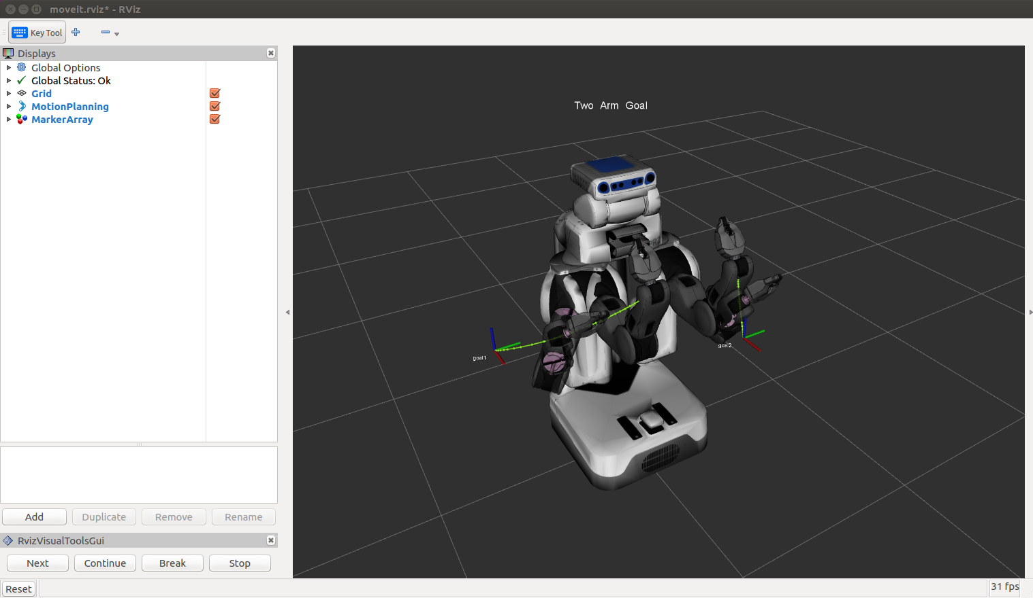
rviz

Slide 23
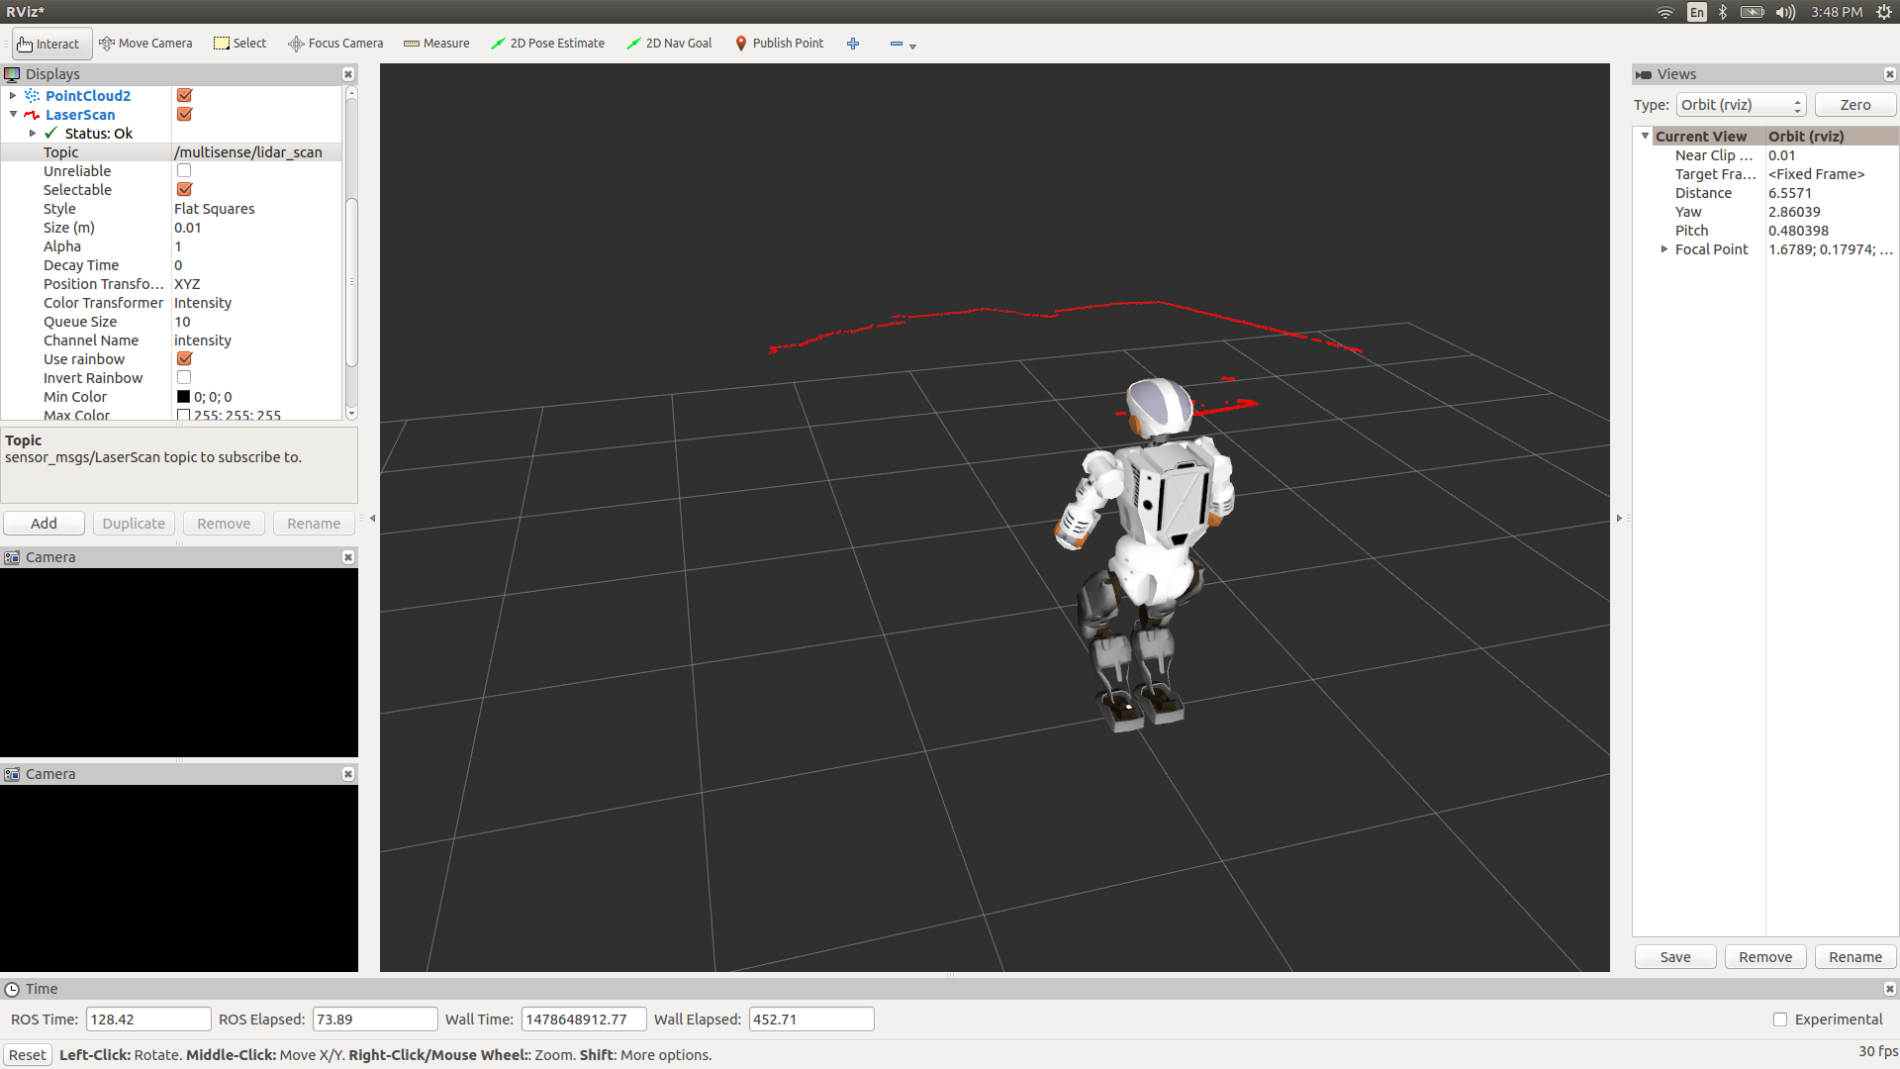
rviz

Slide 24
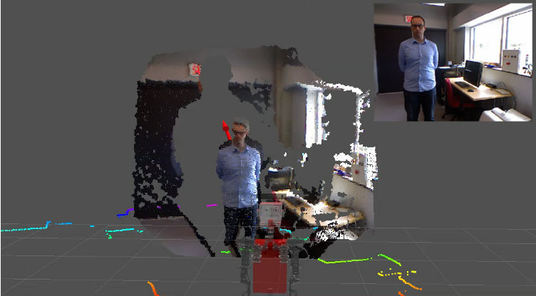
rviz

Slide 25
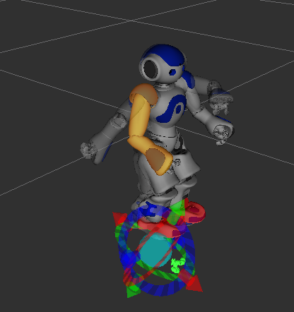
rviz

Slide 26
How to Install ROS?
Installing ROS on PC – Ubuntu
Installing ROS on Virtual Machine
Installing ROS on Raspberry Pi 3 - Jessie
Installing ROS on Raspberry Pi – Ubuntu Mate

Slide 27
ROS Workspace Environment
Standard name for it catkin_ws
You can use whatever name you want.
Check your work space.
First you need to source your setup.*sh.
The setup.bash files setup your environment variables and paths.
source /opt/ros/<distro>/setup.bash
Ex: source /opt/ros/kinetic/setup.bash

Slide 28
Create a Catkin Workspace
What is catkin?
A catkin workspace is a folder where you modify, build, and install catkin packages. (wiki.ros.org)
Catkin packages can be built as a standalone project, in the same way that normal cmake projects can be built, but catkin also provides the concept of workspaces, where you can build multiple, interdependent packages together all at once.

Slide 29
Create a Catkin Workspace
- mkdir -p ~/catkin_ws/src
(create a new directory called src in another directory called catkin ws)
- cd ~/catkin_ws/src
( go into the src directory)
- catkin_init_workspace
(initialize the workspace)
cd ~/catkin_ws/
(go into your brand new workspace)
catkin_make
(build your code in a catkin workspace)
source devel/setup.bash
(Before continuing make sure you source your new setup.*sh file)
echo $ROS_PACKAGE_PATH
Test your path: /home/youruser/catkin_ws/src:/opt/ros/kinetic/share

Slide 30
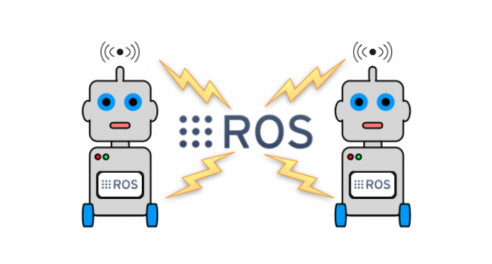
ROS Master
In charge of managing the communication between nodes
Every node registers with the master when you run them
It tracks publishers and subscribers to topics as well as services.
The role of the Master is to enable individual ROS nodes to locate one another.
Once these nodes have located each other they communicate with each other peer-to-peer.
The Master also provides the Parameter Server.

Slide 31
ROS Master
In order to start a master type:
roscore

Slide 32
Ros Nodes
Single-purpose, executable program written in Python, C++, Matlab etc
Individually complied, executed and managed.
You can run, stop, and kill nodes whenever you want.
They run in parallel.
In order to run a node type:
rosrun package_name node_name
See active nodes running on ROS
rosnode list
In order to get more information about nodes type:
rosnode info node_name

Slide 33
ROS Master and Nodes
ROS Master
Registration
Registration
Registration
Node 1
Node 2
Node 3

Slide 34
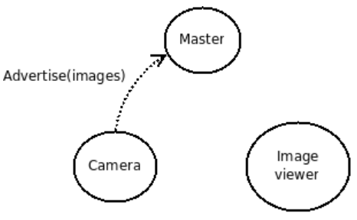
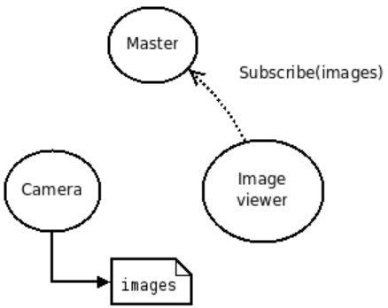
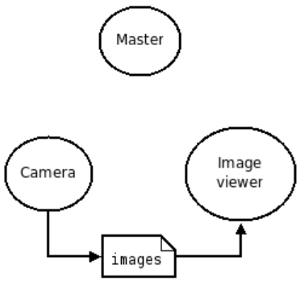
ROS Master Example
Step 1
Step 2
Step 3

Slide 35
ROS Topics
ROS Nodes communicate over topics.
Each node can publish or subscribe topics
When one of the nodes register with the master, node also tells master that I am the publisher of these topics. Therefore, other nodes can know who publishes that topic and subtribe that topic.
List all active topics :
rostopic list
Subscribe and print the contents of a topic
rostopic echo /topic-name
Show information about the topic
rostopic info /topic-name
Show all the other possible rostopic commands
rostopic -h

Slide 36
Other ROS Topic Commands
rostopic bw display bandwidth used by topic
rostopic echo print messages to screen
rostopic hz display publishing rate of topic
rostopic list print information about active topics
rostopic pub publish data to topic
rostopic type print topic type

Slide 37
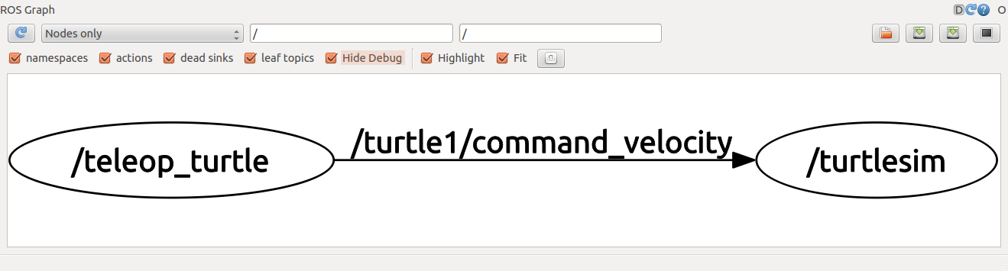
Using rqt-graph
rqt_graph tool is used to create a dynamic graph of what's going on in the system that includes all nodes and topics
To run rqt-graph
rosrun rqt_graph rqt_graph

Slide 38
ROS Master, Nodes, Topics
ROS Master
Registration
Registration
Registration
Node 1
Publisher
Node 2
Subscriber
Node 3
Subscriber and Publisher
Subscribe
Publish
Publish
Subscribe
Topic
Topic

Slide 39
ROS Messages
ROS message describes the data values that ROS nodes publish.
Messages help ROS tolls to automatically generate code for the message type in several target languages.
Message descriptions are in .msg files in the msg/ directory.
Messages can be nested in each other.
Each ROS distribution can have a different description for a message
You can go to http://wiki.ros.org/msg and check the message type
Publish a message to a subscriber ROS node on command line.
rostopic pub /mytopic std_msg/String “data: ‘Portland State University’”

Slide 40
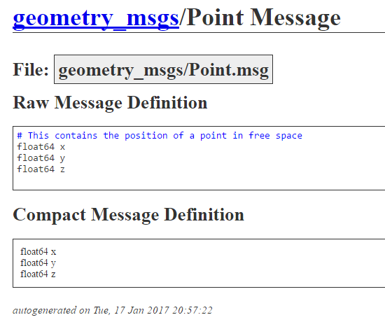
Example ROS Message Definition:

Slide 41
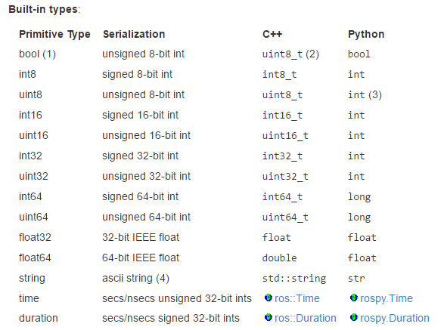
Message Types
You must not use the names of built-in types or header when constructing your own message types.

Slide 42
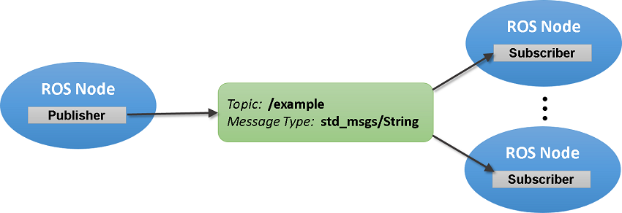
Summary of ROS Messages
Image Source Link

Slide 43
ROS Package
Software in ROS is organized in packages.
A package can contain your ROS nodes, any libraries, a dataset, configuration files, message types, scripts, service types, some third-party software.
When you want to create a project in ROS, first you need to create a package
You can also download and install many packages written by other ROS users around the world
You can submit the ROS package you write to the ROS package repository
Every ROS package is for certain ROS distributions
Packages have dependencies
http://www.ros.org/browse/list.php?package_type=package&distro=indigo

Slide 44
ROS Launch
Sometimes you have so many nodes with many different arguments and parameters to run in a project.
Roslaunch is a tool for easily launching multiple ROS nodes as well as setting parameters in the parameter server.
The basic idea is to list, in a specific XML format, a group of nodes that should be started at the same time.

Slide 45
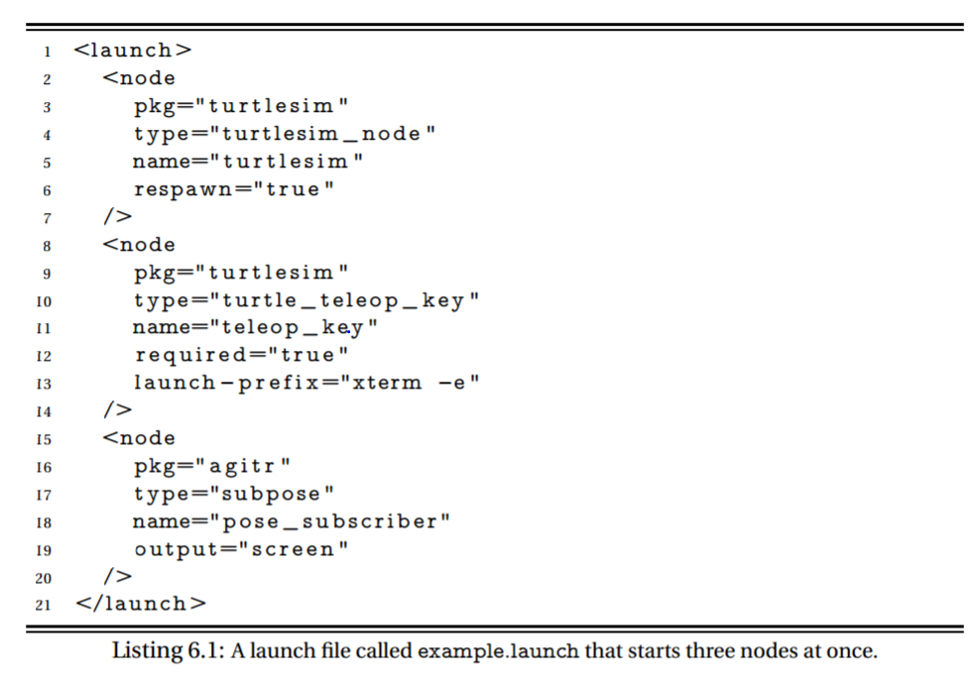
Example Launch File

Slide 46
Some useful ROS command-line tools
rospack: find and retrieve information about packages
catkin_create_pkg: create a new package
catkin_make: build a workspace of packages
rosdep: install system dependencies of a package
rqt: In rqt there is a plugin called "Introspection/Package Graph", which visualizes package dependencies as a graph

Slide 47
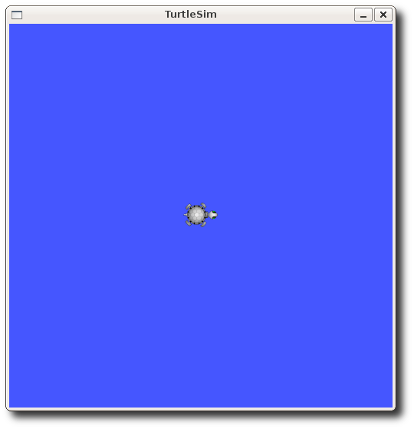
Turtlesim Example
Roscore
Nodes:
rosrun turtlesim turtlesim_node
rosrun turtlesim_turtle_teleop_key
Rostopic:
rostopic pub -1 /turtle1/cmd_vel geometry_msgs/Twist -- '[2.0, 0.0, 0.0]' '[0.0, 0.0, 1.8]'
http://wiki.ros.org/turtlesim

